Slide 2
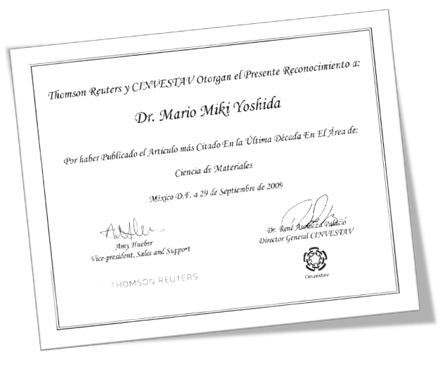

Publicaciones Relevantes
Thin Solid Films 350 (1999) 192-202
Growth, structure and optical characterization of high quality ZnO thin films obtained by spray pyrolysis. F. Paraguay D, W. Estrada L., D.R. Acosta N., E. Andrade, M. Miki-Yoshida

Slide 3



Posición 7
Journal of Molecular Structure: THEOCHEM
Abril - Junio 2009
Theoretical calculations of molecular dipole moment, polarizability, and first hyperpolarizability of glycine-sodium nitrate
Journal of Molecular Structure: THEOCHEM, Volume 905, Issue 1-3, July 2009, Pages 76-80
Hernandez-Paredes, J.; Glossman-Mitnik, D.; Duarte-Moller, A.; Flores-Holguin, N.
Posición 4
Materials Research Bulletin
Julio-Septiembre
Microwave-hydrothermal synthesis of the multiferroic BiFeO"3.
Materials Research Bulletin, Volume 44, Issue 8, Pages 1734-1737. Prado-Gonjal, J.; Villafuerte-Castrejon, M.E.; Fuentes, L.; Moran, E.
Posición 17
Evolution of chemical species during electrodeposition of uranium for alpha spectrometry by the Hallstadius method
Applied Radiation and Isotopes, Volume 67, Issue 9, September 2009, Pages 1559-1569 Beesley, A.M.; Crespo, M.T.; Weiher, N.; Tsapatsaris, N.; Cozar, J.S.; Esparza, H.; Mendez, C.G.; Hill, P.; Schroeder, S.L.M.; Montero-Cabrera, M.E.
Applied Radiation and Isotopes
Abril – Junio 2009
A la fecha 10 artículos en 12 posiciones

Slide 4






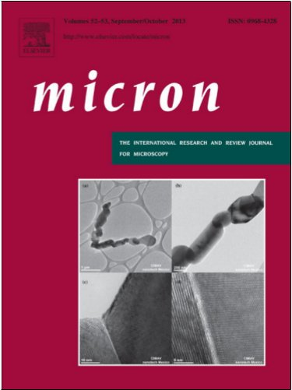


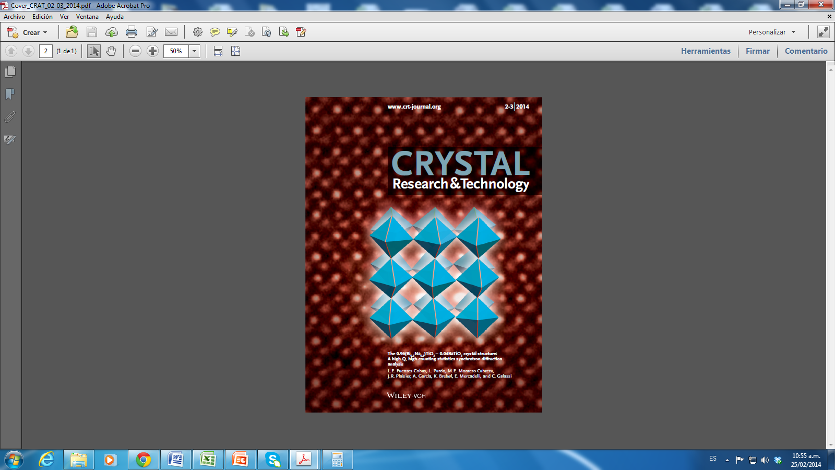


  Posición 1
  Environmental
  Science, Journal of Environmental Radioactivity
  July - September 2006
Posición 12
Engineering > Construction and
Building Materials
April - June 2005
Ártículo más citado en la última década, en el área de materiales
Thin Solid Films 350 (1999) 192-202
Growth, structure and optical characterization of high quality ZnO thin films obtained by spray pyrolysis. F. Paraguay D, W. Estrada L., D.R. Acosta N., E. Andrade, M. Miki-Yoshida
  Posición 3
  Chemistry Journal
  of Molecular
  Structure:
  THEOCHEM
  Posición 7 2009
Posición 17
Applied Radiation and Isotopes
Abril – Junio 2009
Ferroelectric self-assembled PbTiO3
perovskite nanostructures onto
(100)SrTiO3 substrates from a novel
microemulsion aided sol–gel
Preparation method
  Posición 18
  Computer Science Optical Fiber Technology
  October – December
  2006
  Posición 4
  Materials Research Bulletin
  Julio-Septiembre 2009
  Posición 14
  Energy > Solar Energy
  October - December 2005
  “Photovoltaic solar cells performance at elevated temperatures”
Posición 20
Materials Science > Journal of Non-Crystalline Solids
January - March 2006
Artículos en Portadas

